Slide 1
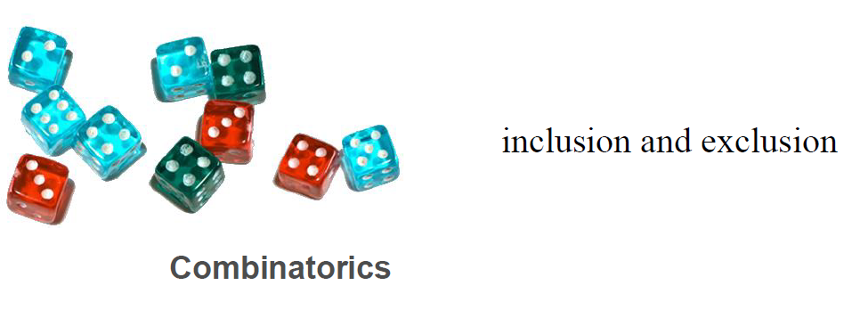
Principle of

Slide 5
A
B
1
4
5
3
2
6

Slide 6
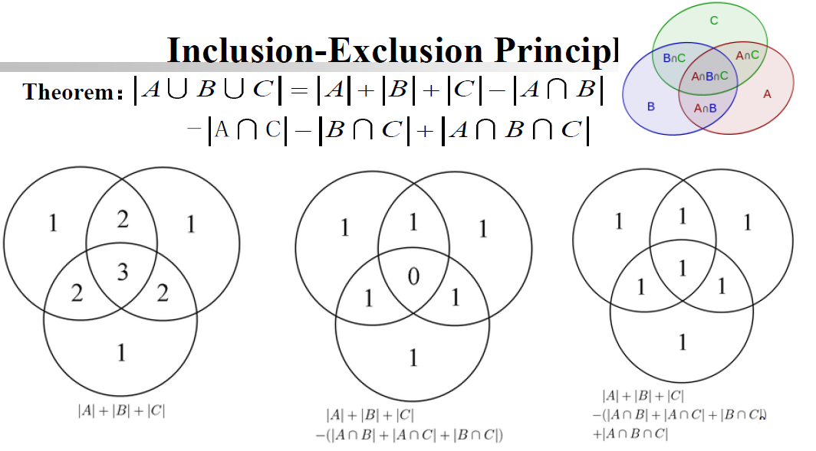
The number written shows how may times cardinality of the subset counted
on successive inclusion and exclusion

Slide 7
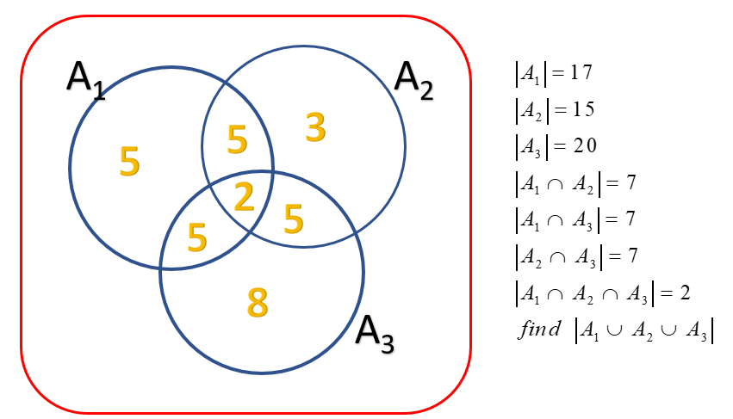
The number written shows cardinality of the subset

Slide 8
N=4 sets

Slide 9
For n=3
For n=4

Slide 10
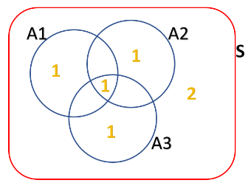
Simplified Notation
The number written shows
cardinality of the subset
More Concise Notation

Slide 11
Connecting to De Morgan’s Law

Slide 12
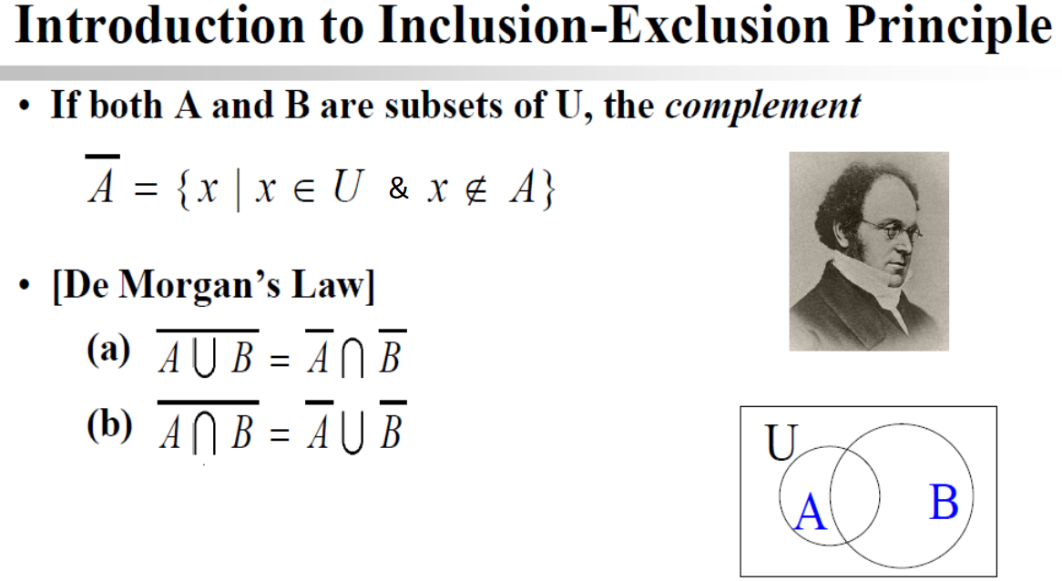

Slide 13
S
A
B

Slide 14
More
Explicit
Notation

Slide 17
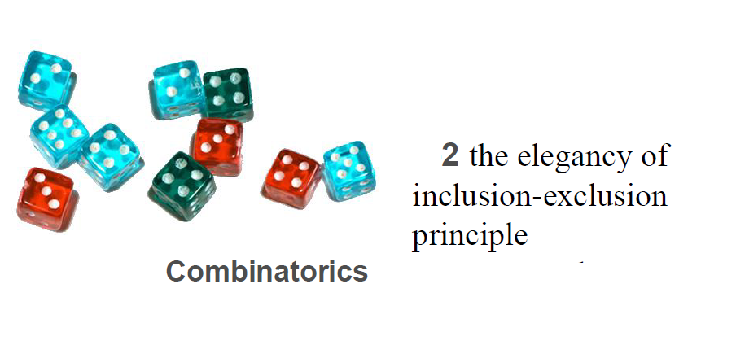

Slide 19
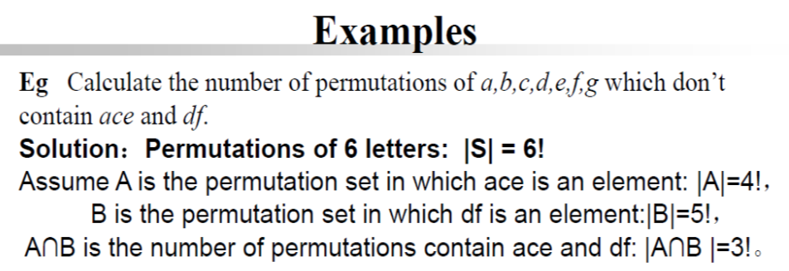

ace
b
d
e
df
a
b
c
e
ace
df
b
Note: g is not there. It is a mistake

Slide 20
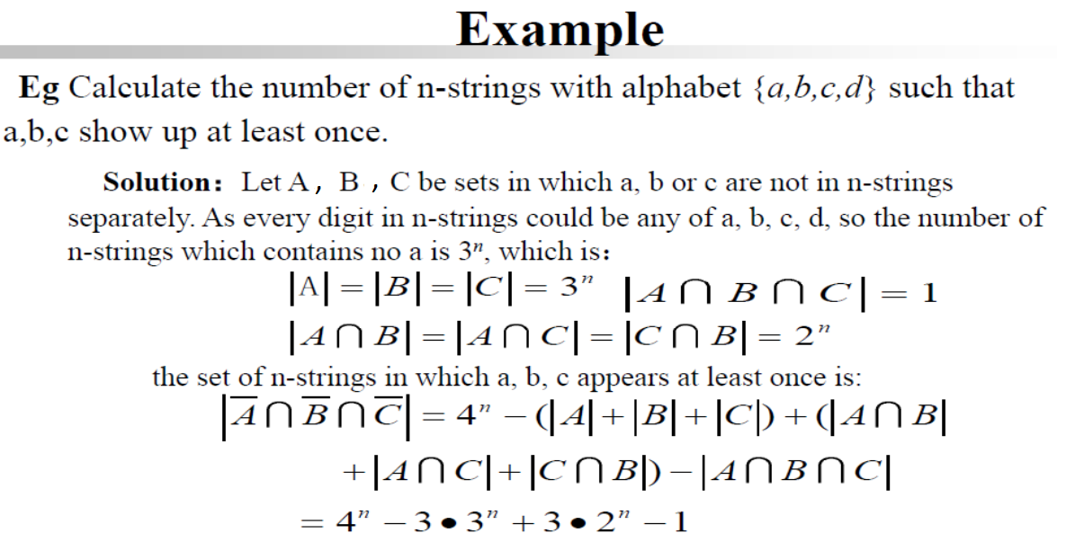
ddddddddd
a is there and
b is there
and c is there
aabcdabcd
All letters a,b,c must be there at least once.
bcdbcdbcd
No a

Slide 21
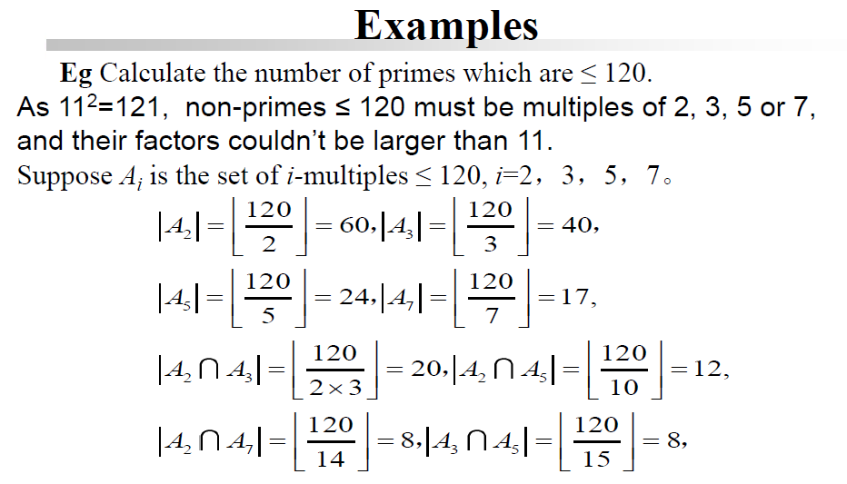
One prime factor must be less than its square root

Slide 22
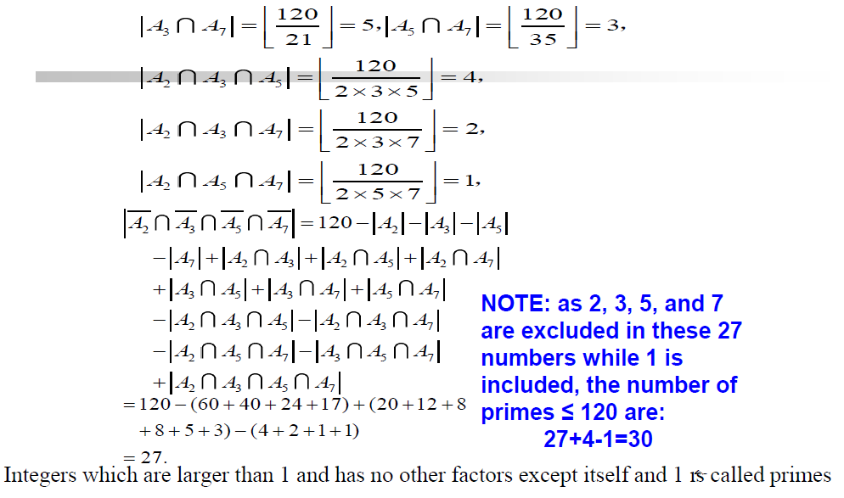

Slide 23
Two numbers are relatively prime if there
is no common divisor other than one
8=2³, so Remove all multiples of 2 to get φ(8)

Slide 25
Think of (x-a)(x-b)(x-c) = x³ – (a+b+c) x² + (ab+ac+bc)x-abc

Slide 26
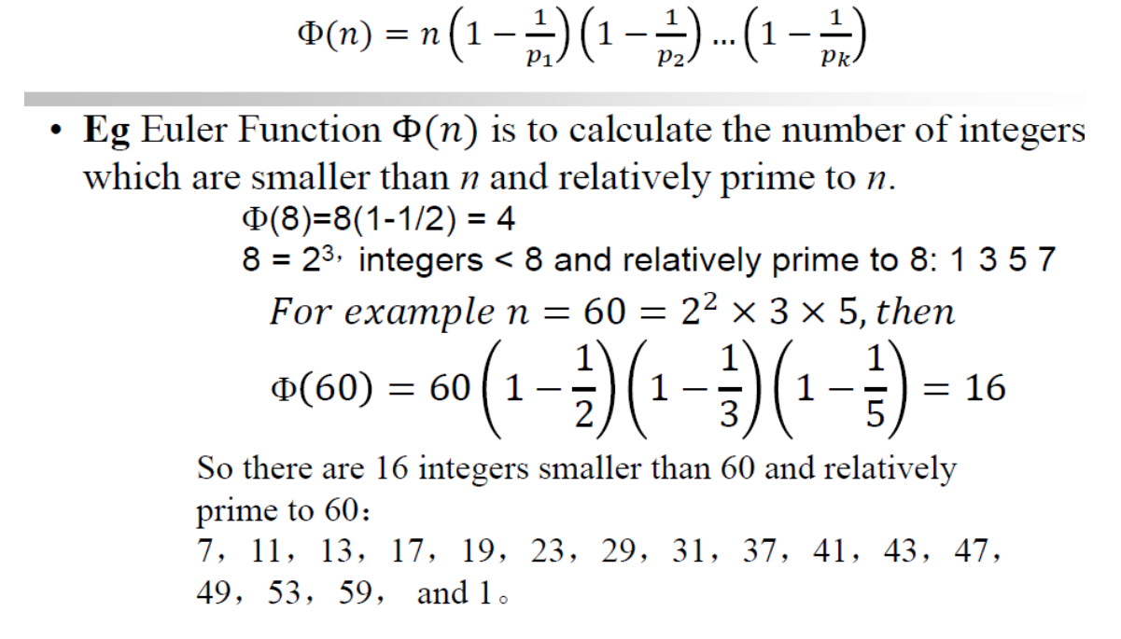

Slide 27
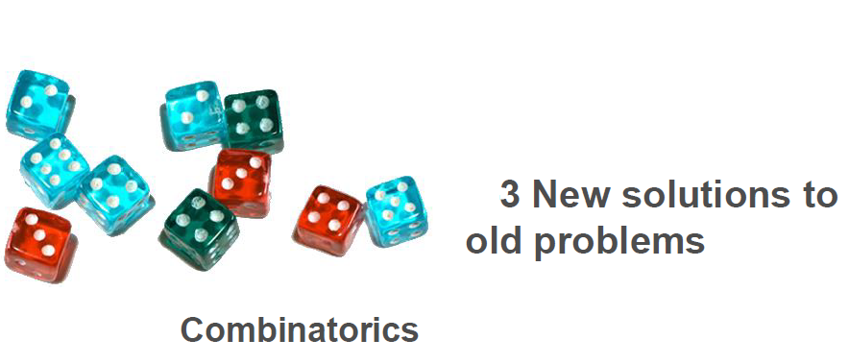

Slide 28
Calculate number of non-negative integer
solution to
x₁+x₂+x₃=15
C(n+b-1, n-1)=C(17,2)=¹⁷C₂
n= Number of variables=3
b=sum=15
C stands for Combination function

Slide 29

How will you distribute 5 toffee to 3 kids
Consider 5+3-1 locations(circle) and 3-1=2 bars
If we place the bars at any of the two locations,
It will partition 5 into 3 sets. One or two can be null set.
2 bars can be placed in ⁷C₂ ways

Slide 30
Calculate number of non-negative integer
solution to
x₁+x₂+x₃=15 with the constraints

Slide 33
Another solution

Slide 34
x=zeros(1,10); y=x; z=x;
x(1:7)=1; y(1:8)=1; z(1:9)=1;
x1=conv(x,y);
x2=conv(x1,z);
x2(16)

Slide 35
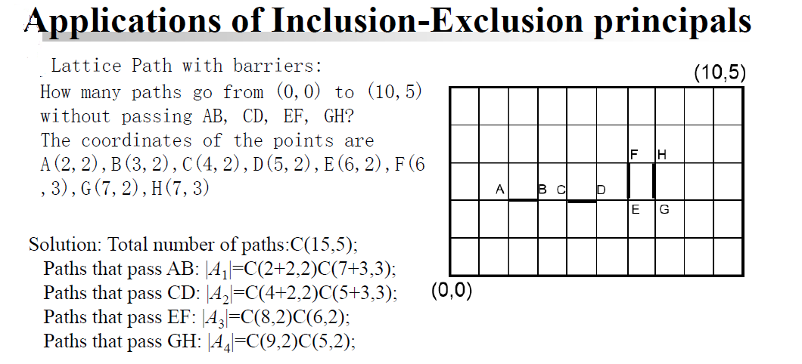

Slide 36
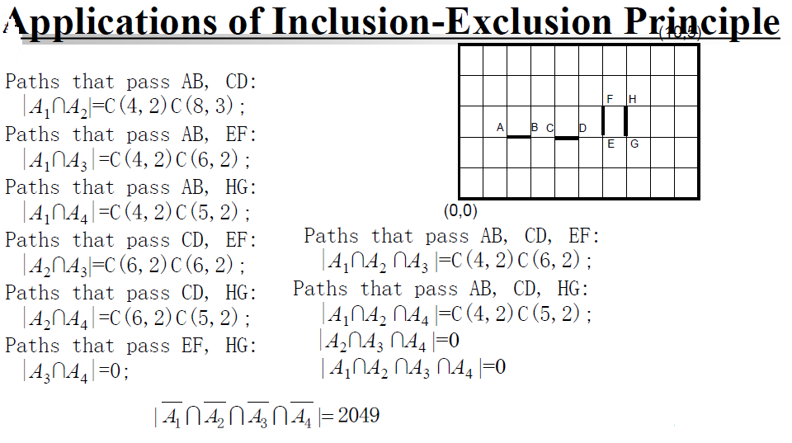

Slide 37
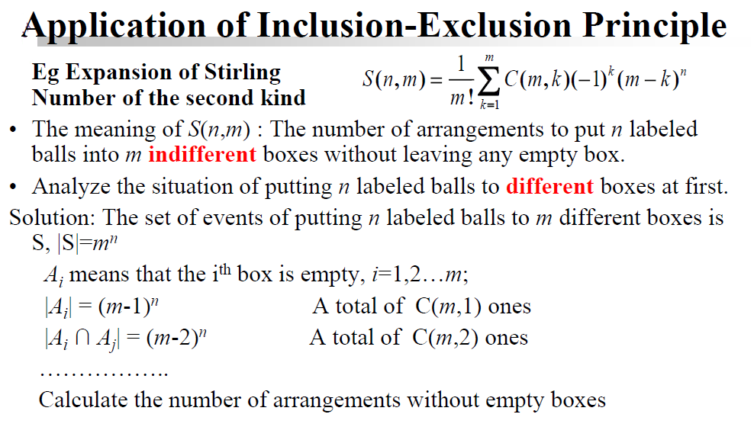

Slide 38
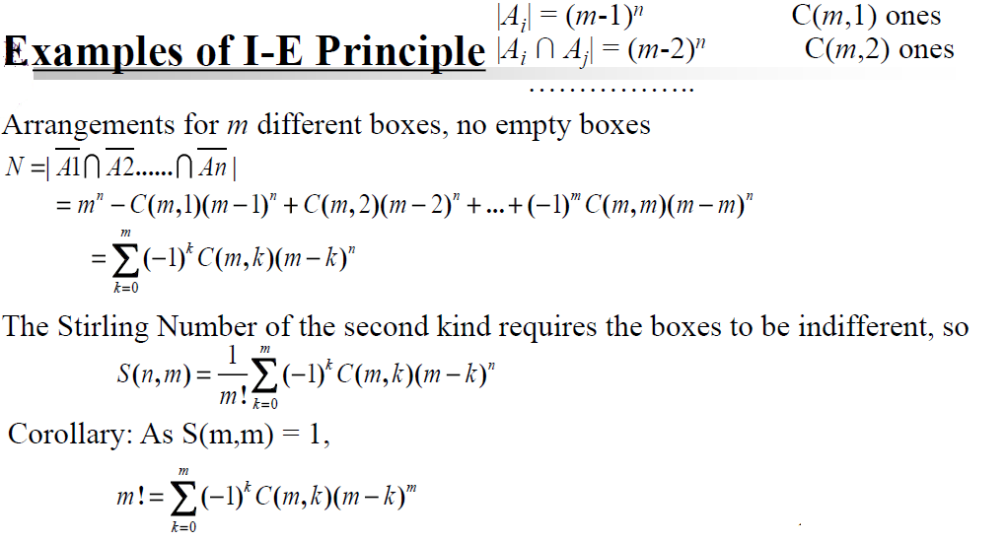

Slide 39
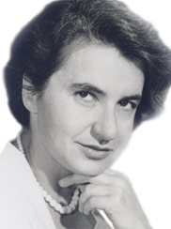
Rosalind Franklin
A crucial contribution. Rosalind Franklin made a crucial contribution to the discovery of the double helix structure of DNA, but some would say she got a raw deal. Biographer Brenda Maddox called her the "Dark Lady of DNA," based on a once disparaging reference to Franklin by one of her coworkers. Unfortunately, this negative appellation undermined the positive impact of her discovery. Indeed, Franklin is in the shadows of science history, for while her work on DNA was crucial to the discovery of its structure, her contribution to that landmark discovery is little known.
Her education. Franklin was born on July 25, 1920, in London, to a wealthy Jewish family who valued education and public service. At age 18, she enrolled in Newnham Women's College at Cambridge University, where she studied physics and chemistry. After Cambridge she went to work for the British Coal Utilization Research Association where her work on the porosity of coal became her Ph.D. thesis, and later it would allow her to travel the world as an guest speaker.
In 1946, Franklin moved to Paris where she perfected her skills in X-ray crystallography, which would become her life's work. Although she loved the freedom and lifestyle of Paris, she returned after four years to London to accept a job at King's College.

Slide 40
Rosalind Franklin Young Investigator Award
The Gruber Foundation funds the Rosalind Franklin Young Investigator Award – a career development research award of $75,000 over three years - to 2 young woman geneticists from anywhere in the world. One award will fund genetics research in human and non-human mammals, and the other will fund genetics research in model organisms. This unrestricted cash award is presented every three years. The successful candidate must be in her first one to three years of an independent faculty-level position in any area of genetics.
https://gruber.yale.edu/rosalind-franklin-young-investigator-award

Slide 41
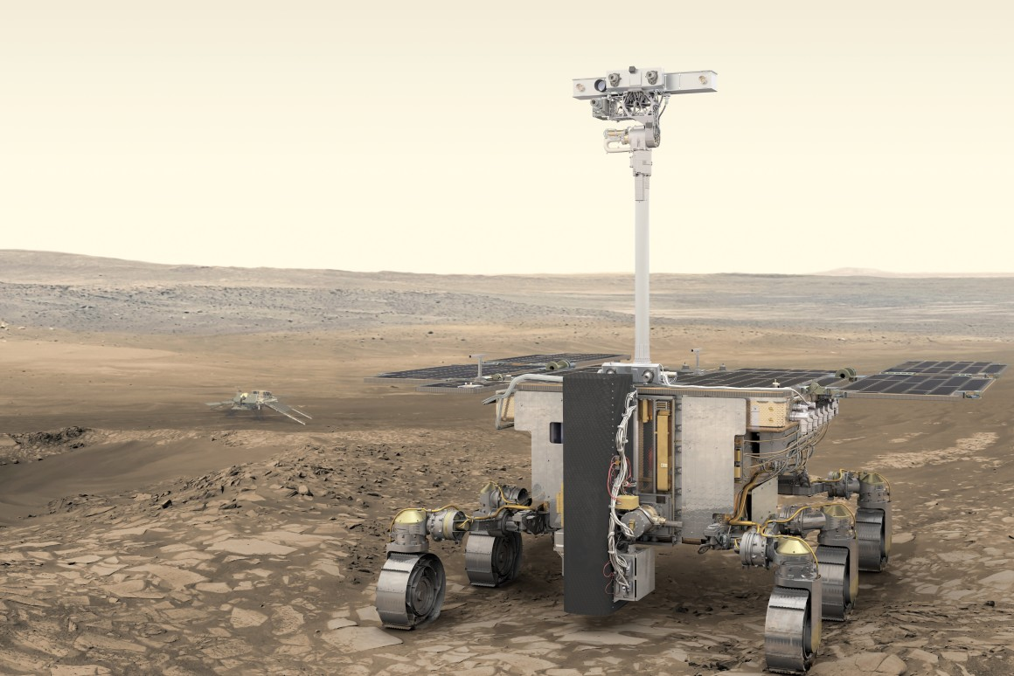
https://www.youtube.com/watch?time_continue=21&v=u6Gc0nvN9xs&feature=emb_logo

Slide 42
‘Rosalind Franklin’ Mars rover complete ahead of Red Planet mission
Testing due to take place in France before planned departure in July 2020

Slide 44
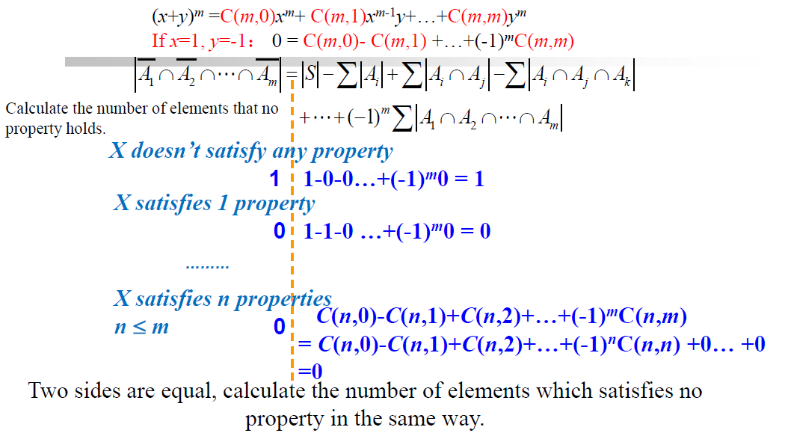

Slide 46
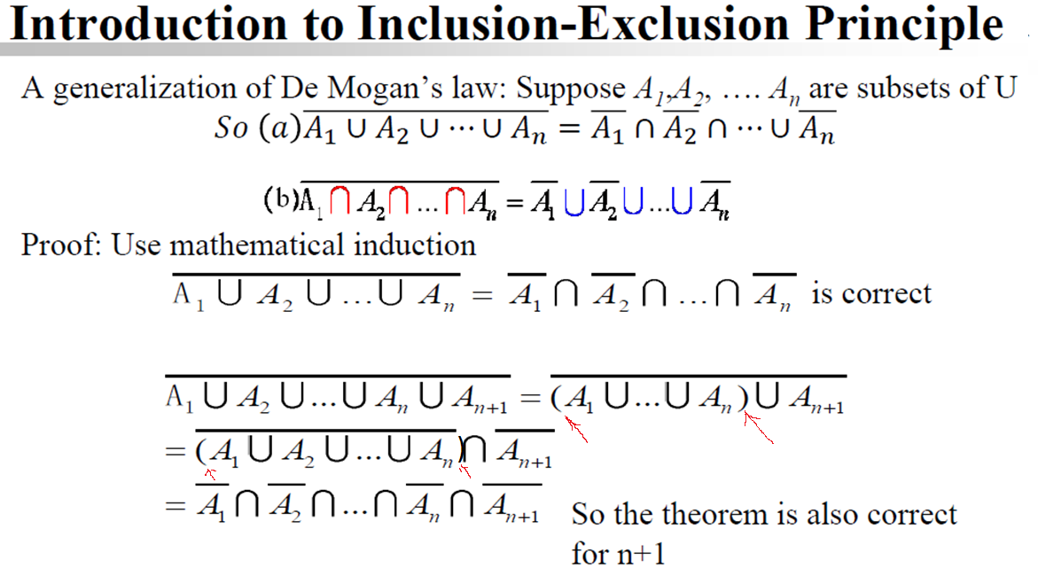

Slide 47
S
A₁
A₂

Slide 48
Walking on a grid.

Slide 49
(7,4)
(0,0)
How many ways one can move from left corner (0,0) to (7,4)
if one is restricted to move only forward and upward direction
Ans=⁷⁺⁴C₄=¹¹C₄=¹¹C₇

Slide 50
(7,4)
Path (green line segments)
for 00010001101
(0,0)
The movement can be encoded by a vector of length 11 (=7+4) with elements
0 and 1. If 0 represent forward move, then 1 represent upward move.
Then the string should have 7 zeros and 4 ones as given below.

Slide 51
In Matlab how will you randomly generate a vector with 7 zeros and 4 ones. How will you plot it?
One solution:
Initialize an array of length 11 with zeroes
Select 4 indices from 1 to 11 randomly.
At these locations put 1 in the array.
Generate and x and y coordinates for the path
Plot the line segments

Slide 52
In Matlab, How will you generate
The 0-1 code for all paths

